Slide 1
Software Engineering and Architecture
Release Management &
Branching Models

Slide 2
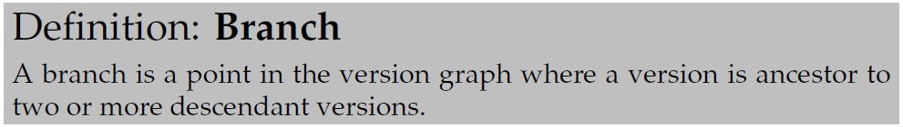
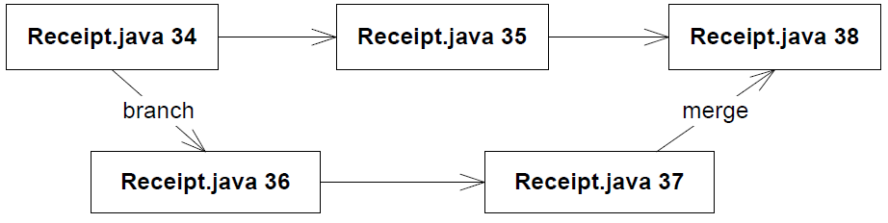
Branching

Slide 3
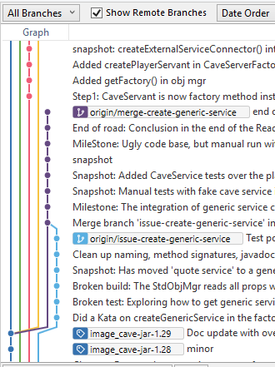
Git branches
Git is really strong in branching
support !
  Why? Because it is a powerfull
  development tool…
Example: feature branch
  Arne makes branch ‘add-german’
  and change code without interfering
  with Bente
  Bente makes branch ‘fix-bug-21’
  and fixes – well – bug #21
Merge back when done
  Or orphan branch if really bad idea…

Slide 4
Software is a Lab!
I do a lot of experiments on my code!
  I was originally trained as a physicist ☺
Experiment = I think this is a good idea, but do not know?
How do I get ‘to know!’ By doing it!
Make an experimental branch in git
  It was a good idea! Merge that branch into main
  It was a bad idea!!! Orphan the branch

Slide 5

Release Management
You need to know what you release!
  Users report bugs and you need to fix them fast on the right code
Example
  Release to AlphaTown
    Rewrite part of the AlphaTown code to support BetaTown
      (Major refactorings in core AlphaTown code)
  AlphaTown phones us ”Hurry, fix major bug now”
    But the code base is in a ‘state of flux’ (read: messy, broken, …) and also includes new features that AlphaTown has not paid for
  What to do???

Slide 6
Not all versions are equal
Some versions attain a special meaning: Release
How to manage?
  Write down the version identity. Git: 4ef678a…
  ‘Tag’ a version on the graph.
    Essentially put a human readable label on specific version
  Make a ‘release branch’ (single release branch model)
    Branch and name the new branch ‘Release-AlphaTown-V1.7.4’
  Merge into a ‘release branch’ and tag it (major release branches model)
    Merge current version into global release branch and tag it
  Main branch is the ‘release branch’, no dev on this branch
    “GitHub Flow” model

Slide 7
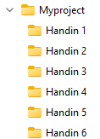
(SideNote)
Some of you have in a previous course handed in mandatories using Git but made one folder pr hand-in?
  I.e. ‘releases’ of the mandatory project
This is not the software dev way!
  This is a 1990’es manual hack in the absence
  of a version control system
SWEA: We use Git to do release
management

Slide 8
Two Release Management Models
Single Release Branch Next slide
  Daily development on ‘master’
  New release => Merge into ‘release’ branch
  Pro: Always find release as tip on release branch
Major Release Branches Next+1 slide
  New release => Create new branch
  Pro: Naming the releases by the branch name
Used in SWEA up until E2020…

Slide 9
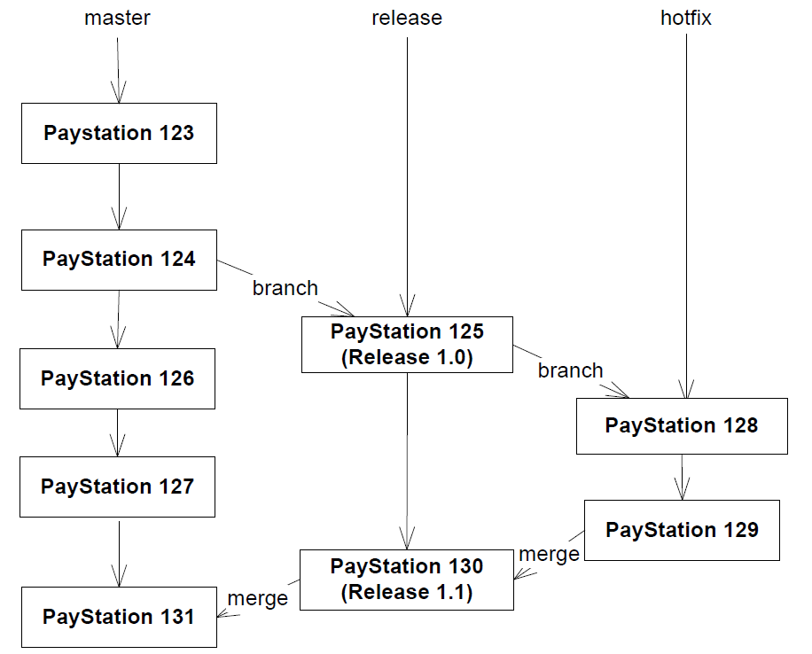
Simple Release Model A
Single Release Branch
  Hotfixing must be done
  on separate branch
  And merged back
Notes:
If hotfix is not on seperate branch then latest version is NOT a release

Slide 10
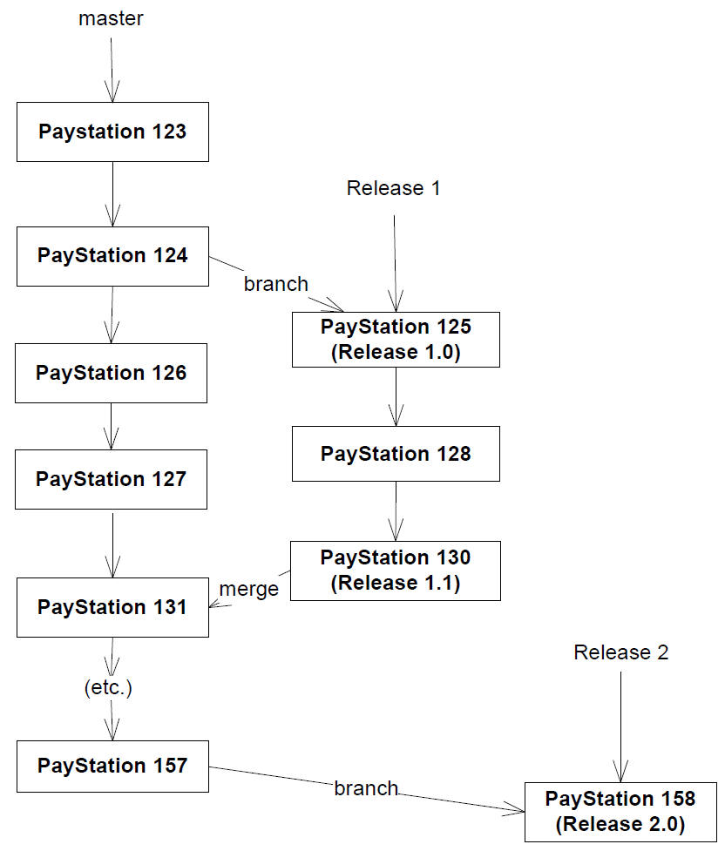
Simple Release Model B
Major Release Branches
  Each major release give
  rise to new branch

Slide 11
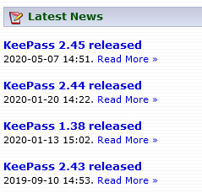
Continuous Deployment
Release Management is important but…
  There is a distinct release process involved
  I download the latest release and install
Lots of modern software does not
follow that paradigm
  You do not download & install facebook
  Web systems are continuously updated…
CD = You continuously get the latest release
  Releasing every couple of hours! Done by machines…

Slide 12
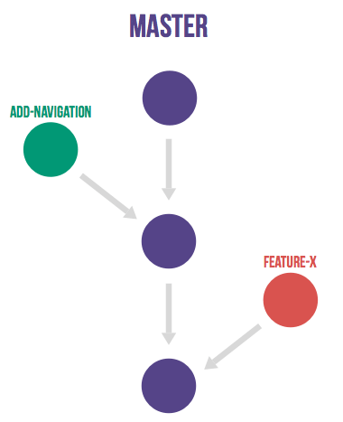
CD Release Management
CD streamlines release management!
  ‘main’ is the release branch!
Daily work done on feature branches
  When feature/iteration is ‘working’…
    Tests pass, requirements complete
  … you merge back into master
GitHub Flow
  [https://docs.github.com/en/get-started/quickstart/github-flow]
  Note: This release management model is not tied to GitHub!
main

Slide 13
SWEA Relation
In the SWEA mandatory project…
You should create an ‘iteration branch’ that holds the development in the given iteration / delivery
Like branch ‘iteration3’ =
  Work on the requirements for mandatory ‘iteration 3’
    Contains ‘work in progress’ code, not suitable for customers
  But ‘main’ branch can always be released
    Because it is correct, working, without bugs, stable, latest…

Slide 14
GitHub Flow
In Practice

Slide 15
Overview
main
1. Tell Git to create branch
Iteration 3

Slide 16
Overview
main
(2.) Associate ‘Merge Request’ with the branch
Iteration 3

Slide 17

Overview
main
3. Develop on that branch, commit often ☺
Iteration 3

Slide 18

Overview
main
Iteration 3
4. Release: Merge back into main branch

Slide 19
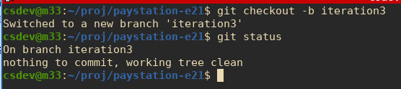
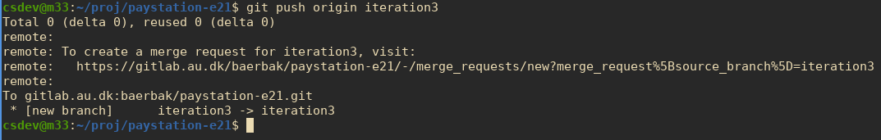
Starting Iteration Work
Let us start on the exciting mandatory 3 – hurrah!
Tell GitLab about the branch
  Link will be provided if you want to create a ‘merge request’
To see same procedure in IntelliJ’s git, see screencasts on week plan…

Slide 20
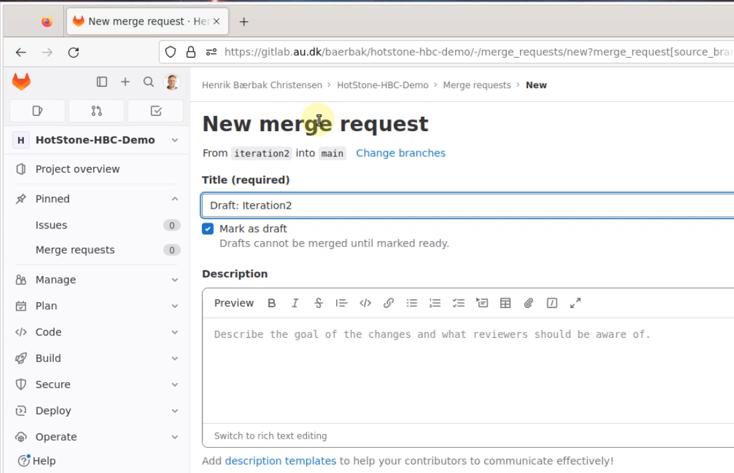
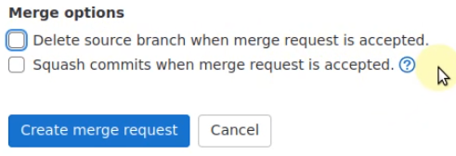
(Merge Request)
Follow the link that Git provides
And fill in the details about Description, and ‘Create…’
Aka: Pull Request

Slide 21
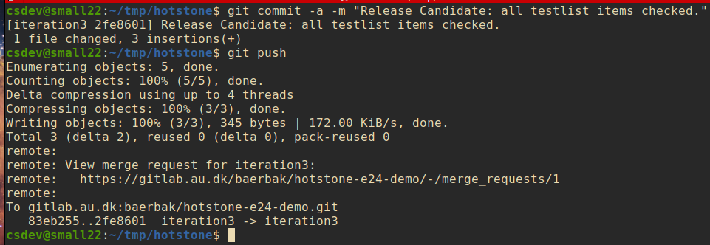
Now: Work ☺
Do the TDD
  Do a ‘commit and push’ after each finished TDD iteration

Slide 22
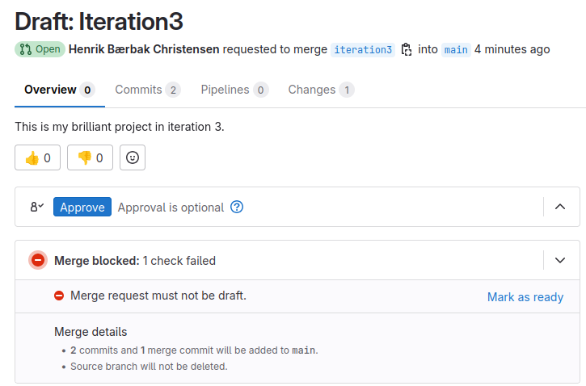
Release Time
We find it is time to release
  That is: this is the best shot at a mandatory hand-in
(Mark the iteration branch as ‘ready’ in AU GitLab)

Slide 23
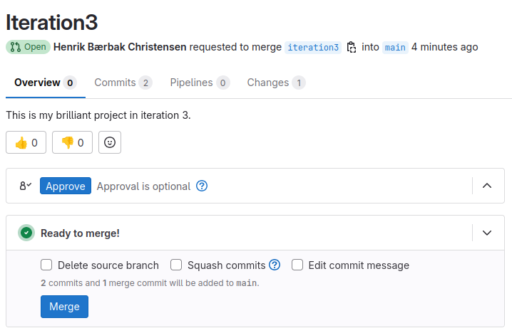
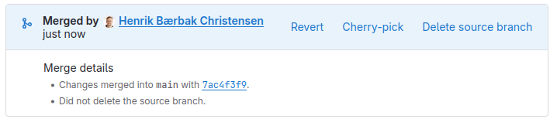
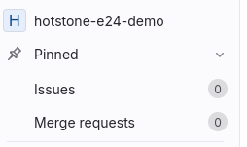
And merge back to Main

Slide 24
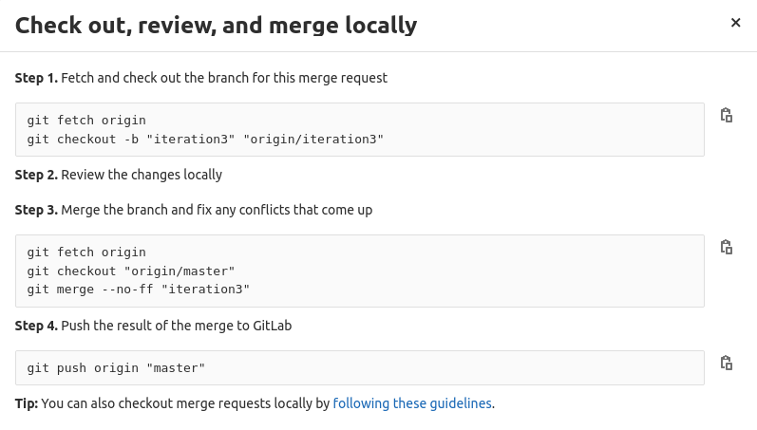
Release Time
The ‘commandline’ way
Or use the - -no-commit, to ‘dryrun’

Slide 25
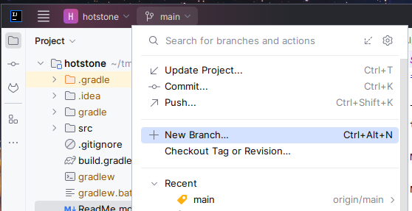
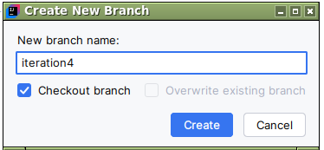
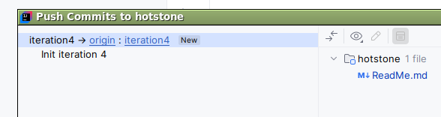
Equivalent in IntelliJ
Branch in IntelliJ; Associate merge request in GitLab;
WORK

Slide 26
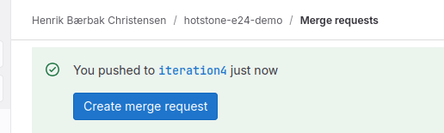
Over to GitLab
And fill in the details as outlined earlier

Slide 27
Merge Request/Branch
I have shown it here where a merge request is associated with the ‘iteration 3’ branch.
  It is a bit overkill in SWEA context to create merge requests, so
  It is optional to do that in the mandatory…
The branch is important, required in mandatory
  Working on an iteration branch is important
    git checkout –b iteration4 Create branch
    git commit & git push Work on branch
    git checkout main; git merge iteration4 Merge back to main

Slide 28
In the Branching Model
Release is now present
on the main branch.
The key point:
  You can always release
  the software on the
  main branch!
CD = Cont. Delivery
  Every 1 hour, a computer
  simply copies SW
  from main branch onto
  production machines
main
Iteration 3

Slide 29
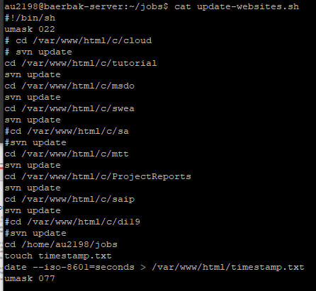
Simple Example
Crontab on ‘baerbak.cs.au.dk’

Slide 30
Summary
Branching supports the release and development process
  Releasing, bugfixing, subteams, feature branches, …
Many different models can be made
  Keep it simple! Emphasize ease in daily work!
In SWEA we adopt a simple CD model – GitHub Flow
  Latest working release on ‘main’
  Do development on an ‘iteration’ branch,
    Optional use ‘merge requests’

